Slide 1

Understanding and Modeling Organizational Systems
2
Kendall & Kendall
Systems Analysis and Design, 9e

Slide 2
Learning Objectives
Understand that organizations and their members are systems and that analysts need to take a systems perspective.
Depict systems graphically using context-level data flow diagrams, and entity-relationship models, use cases, and use case scenarios.
Recognize that different levels of management require different systems.
Comprehend that organizational culture impacts the design of information systems.
2-<number>

Slide 3
Organizations Are Composed of Interrelated Subsystems
Influenced by levels of management decision makers that cut horizontally across the organizational system
  Operations
  Middle management
  Strategic management
Influenced by organizational cultures and subcultures
2-<number>

Slide 4
Organizations as Systems
Conceptualized as systems designed to accomplish predetermined goals and objectives
Composed of smaller, interrelated systems serving specialized functions
Specialized functions are reintegrated to form an effective organizational whole
2-<number>
Notes:
To ascertain information requirements properly and to design appropriate information systems, it is of primary importance to understand the organization as a whole.
All systems are composed of subsystems.

Slide 5
Interrelatedness and Independence of Systems
All systems and subsystems are interrelated and interdependent
All systems process inputs from their environments
All systems are contained by boundaries separating them from their environments
System feedback for planning and control
An ideal system self-corrects or self-regulates itself.
2-<number>
Notes:
When an element of a system is changed or eliminated, the rest of the system’s elements and subsystems are also significantly affected.
Processes change or transform inputs into outputs.
Typical processes include:
verifying
updating
printing
Organizational boundaries exist on a continuum ranging from extremely permeable (open) to almost impermeable (closed).
All organizations (systems) need planning and control to manage their resources effectively. Feedback is useful for planning and control.
The ideal system is one that self-corrects or self-regulates in such a way that decisions on typical occurrences are not required.

Slide 6
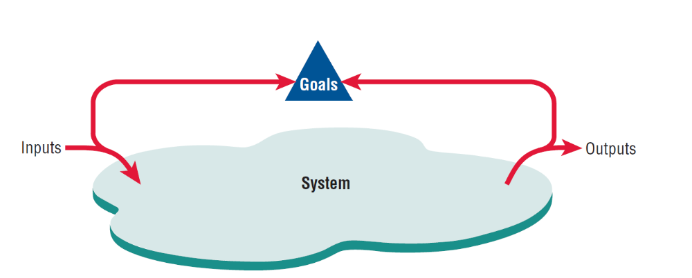
System Outputs Serve as Feedback that Compares Performance with Goals (Figure 2.1)
2-<number>
Notes:
Feedback is received both internal and external to the organization. Anything external to an organization’s boundaries is considered to be an environment.

Slide 7
Organizational Environments
Community
  Physical location
  Demographic profile (education, income)
Economic
  Market factors
  Competition
Political
  State and local government
Legal
  Federal, state, regional, local laws, and guidelines
2-<number>
Notes:
Numerous environments, with varying degrees of stability, constitute the milieu in which organizations exist.
Although changes in environment can be planned for, they cannot be directly controlled by the organization.

Slide 8
Openness and Closedness
Open
  Free flow of information
  Output from one system becomes input to another
Closed
  Restricted access to information
  Limited by numerous rules
  Information only on a “need to know” basis
2-<number>
Notes:
Openness and closedness exist on a continuum, there is no such thing as an absolutely open or completely closed organization.

Slide 9
Virtual Organizations and Virtual Teams
A virtual organization has parts of the organization in different physical locations
Computer networks and communications technology are used to bring virtual teams together to work on projects
2-<number>
Notes:
In some instances, organizations of remote workers have been able to succeed without the traditional investment in infrastructure.

Slide 10
Benefits of Virtual Organizations and Teams
Possibility of reducing costs of physical facilities
More rapid response to customer needs
Helping virtual employees to fulfill their familial obligations to children or aging parents
2-<number>
Notes:
Just how important it will be to meet the social needs of virtual workers is still open to research and debate.

Slide 11
Taking a Systems Perspective
Allows system analyst to understand businesses before they begin their tasks
It is important that members of subsystems realize that they are interrelated with other subsystems
Problems occur when each manager thinks that his/her department is the most important
Bigger problems may occur when that manager rises through the ranks
2-<number>
Notes:
Taking a systems perspective allows systems analysts to start broadly clarifying and understanding the various businesses with which they will come into contact.
Without recognizing the interrelatedness of the subsystems; subsystems cannot properly accomplish their goals.
Managers of different subsystems need to have the same picture of the functioning and interrelatedness of the organization.
In his/her new position, the former manager may still think of his/her old department as the most important. The potential for this problem to occur exists in almost any business. If the analyst interviews this manager early on, he/she may get a distorted view of the company structure.

Slide 12
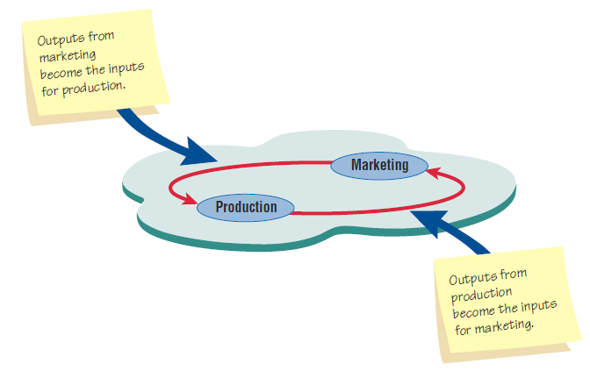
Taking a Systems Perspective (Figure 2.2)
Outputs from one department serve as inputs for another such
that subsystems are interrelated.
2-<number>

Slide 13
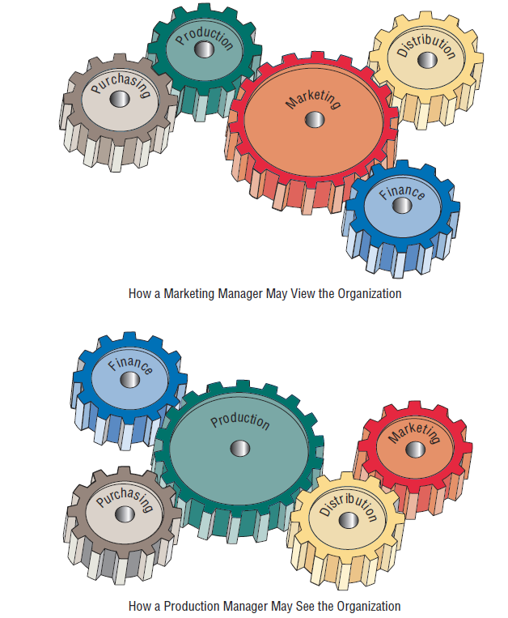
Perspective of Functional
Managers (Figure 2.3)
2-<number>

Slide 14
Enterprise Resource Planning
Enterprise Systems or Enterprise Resource Planning (ERP) describes an integrated organizational information system
Software that helps the flow of information between the functional areas within the organization
2-<number>
Notes:
ERP systems include:
manufacturing components
sales and operations planning
distribution
managing the supply train
Problems with implementation:
difficult to analyze a system currently in use and then fit the ERP model to that system
companies tend to design their business processes before ERP is implemented
ERP, although growing in use is also being viewed with some skepticism.

Slide 15
ERP and the Organization
ERP can affect every aspect of the organization, including:
  Design of employees’ work
  Skills required for job competency
  Strategic positioning of the company
2-<number>

Slide 16
Issues to be Overcome for ERP Success
Many issues must be overcome for the ERP installation is to be declared a success:
  User acceptance
  Integration with legacy systems and the supply chain
  Upgrading functionality (and complexity) of ERP modules
  Reorganizing work life of users and decision makers
  Expanded reach across several organizations
  Strategic repositioning of the company
2-<number>

Slide 17
Depicting Systems Graphically
Context-level data flow diagrams
Entity-relationship model
Use case modeling
2-<number>
Notes:
The various graphical models show the boundaries of the system and the information used in the system.

Slide 18
Context-Level Data Flow Diagrams
Focus is on the data flowing into and out of the system and the processing of the data
Shows the scope of the system:
  What is to be included in the system
  The external entities are outside the scope of the system
2-<number>
Notes:
Sometimes called an environmental model.

Slide 19
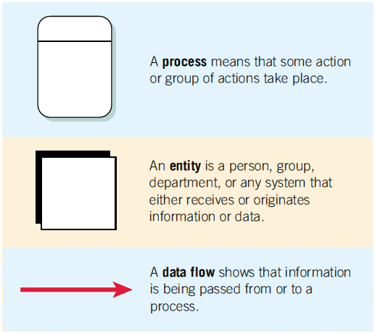
The Basic Symbols of a Data Flow Diagram (Figure 2.4)
2-<number>
Notes:
Process—transforms incoming data into outgoing information, the content level has only one process representing the entire system.
Entity—entity, a person, group, department, or system that supplies or receives information.
Data flows—the lines that connect external entities to the process.

Slide 20
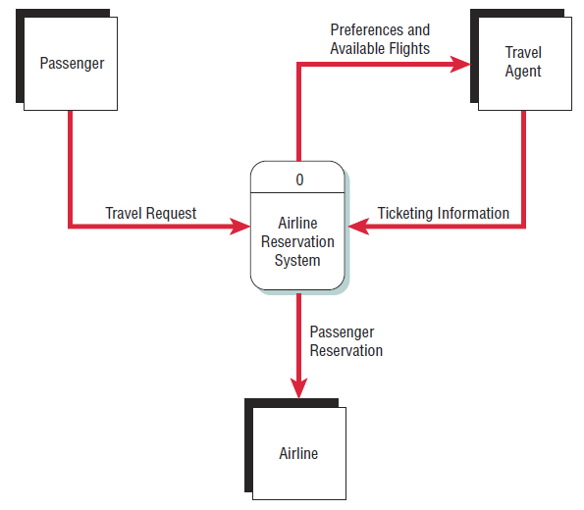
Airline Reservation System (Figure 2.5)
A context-level data flow diagram
for an airline reservation system
2-<number>
Notes:
The passenger (an entity) initiates a travel request (data flow). The passenger’s preferences and the available flights are sent to the travel agent, who sends ticketing information back to the process. The passenger information is also sent to the airline.

Slide 21
Entity-Relationship Model
Focus is on the entities and their relationships within the organizational system
Another way to show the scope of a system
2-<number>
Notes:
An entity may be a person, a place, thing, or an event.
A relationship is the association that describes the interaction among the entities.

Slide 22
Relationships
Relationships show how the entities are connected
Three types of relationships:
  One-to-one
  One-to-many
  Many-to-many
2-<number>
Notes:
One-to-one—one employee is assigned to one phone extension.
One-to-many—many employees are assigned to a department.
Many-to-many—many passengers fly to many destinations.

Slide 23
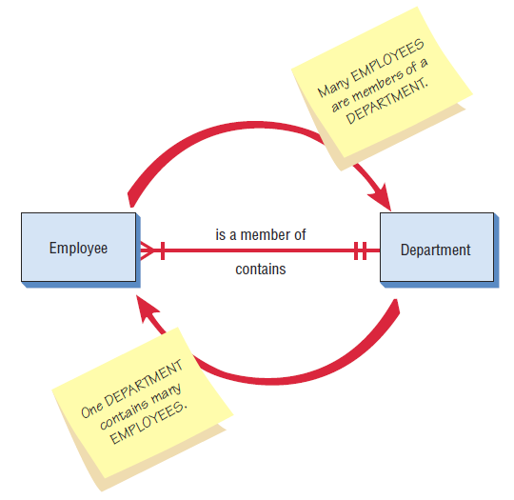
Entity-Relationship Example (Figure 2.7)
An entity-relationship diagram
showing a many-to-one
relationship
2-<number>

Slide 24
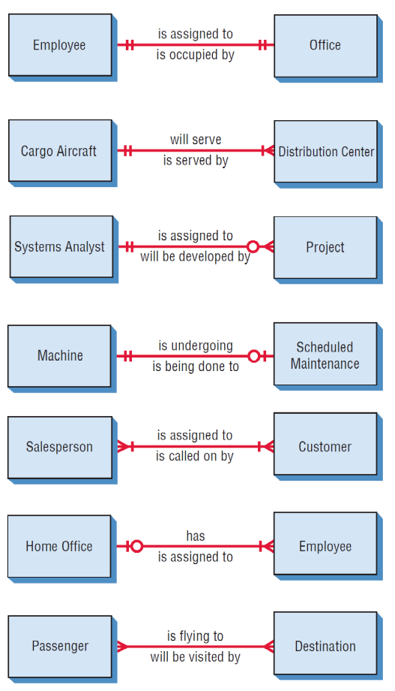
Examples of Different Types of Relationships in E-R Diagrams (Figure 2.8)
2-<number>

Slide 25
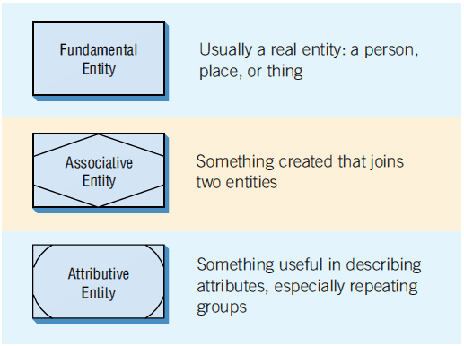
Three Different Types of Entities Used in E-R Diagrams (Figure 2.9)
2-<number>
Notes:
Different symbols are used to represent different types of entities.
An associative entity can only exist if it is connected to at least two other entities.
An attributive entity is used when we want to show data that are completely dependent on the existence of an fundamental entity.

Slide 26
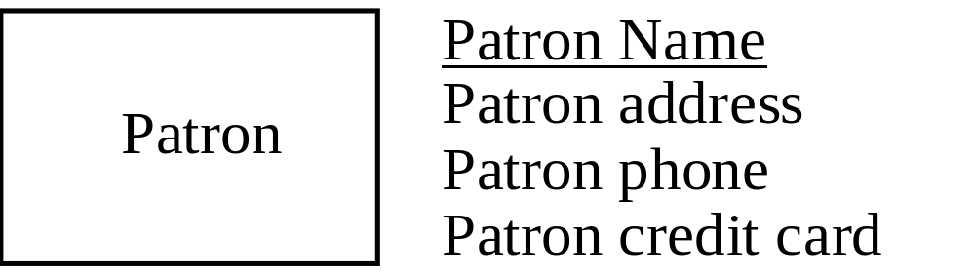
Attributes
Data attributes may be added to the diagram.
2-<number>
Notes:
Data attributes are what make up or define the entity.

Slide 27
Creating Entity-Relationship Diagrams
List the entities in the organization
Choose key entities to narrow the scope of the problem
Identify what the primary entity should be
Confirm the results of the above through data gathering
2-<number>
Notes:
ER diagrams are generally used to model the database.
ER diagrams help the analyst understand what business the organization is actually in, determine the size of the problem, and discern whether the right problem is being addressed. The E-R diagram needs to be confirmed or revised as the data-gathering process takes place.

Slide 28
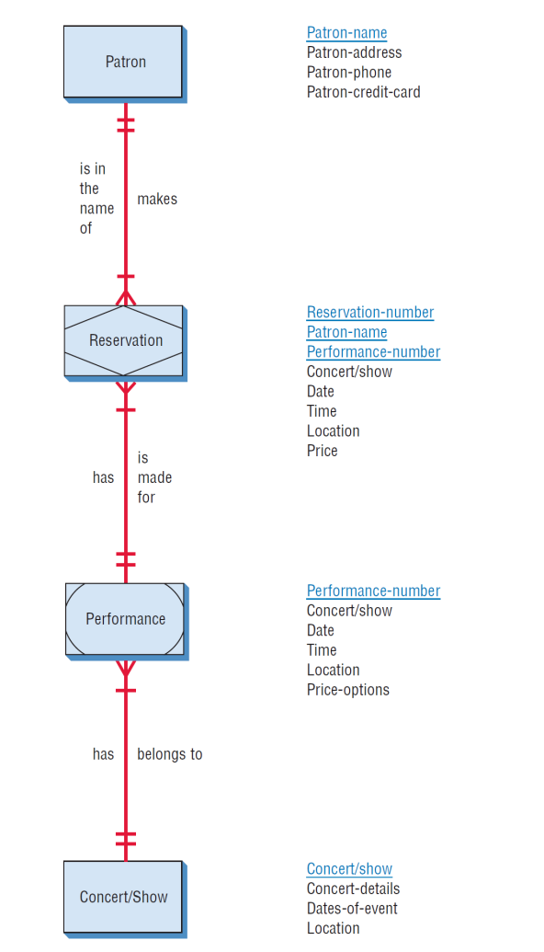
A More Complete E-R Diagram Showing Data Attributes of the Entities (Figure 2.12 )
2-<number>

Slide 29
Use Case Modeling
Describes what a system does without describing how the system does
  A logical model of the system
Use case is a view of the system requirements
Analyst works with business experts to develop requirements
2-<number>
Notes:
Originally, introduced as a diagram for use in the object-oriented UML, use cases are now being used regardless of the approach to systems development. It can be used as part of the SDLC or in agile modeling.

Slide 30
Use Case Diagram
Actor
  Refers to a particular role of a user of the system
  Similar to external entities; they exist outside of the system
Use case symbols
  An oval indicating the task of the use case
Connecting lines
  Arrows and lines used to diagram behavioral relationships
2-<number>
Notes:
A use case always describes three things:
an actor that initiates an event
the event that triggers a use case
the use case that performs the actions triggered by the event

Slide 31
Actor
Divided into two groups
  Primary actors:
    Supply data or receive information from the system
    Provide details on what the use case should do
  Supporting actors:
    Help to keep the system running or provide help
    The people who run the help desk, the analysts, programmers, and so on
2-<number>
Notes:
Sometimes a table is created with actor profiles that lists the actors, their background, and their skills.
These profiles can be useful to understand how the actor interacts with the system.

Slide 32
A Use Case Always Provides Three Things
An actor that initiates an event
The event that triggers a use case
The use case that performs the actions triggered by the event
2-<number>
Notes:
A use case documents a single transaction or event.
An event is an input to the system that happens at a specific time and place and causes the system to do something.

Slide 33
Use Case Relations
Behavioral relationships
  Communicates
    Used to connect an actor to a use case
  Includes
    Describes the situation in which a use case contains behavior that is common to more than one use case
2-<number>

Slide 34
Use Case Relations
Behavioral relationships (continued)
  Extends
    Describes the situation in which one use case possesses the behavior that allows the new case to handle a variation or exception from the basic use case
  Generalizes
    Implies that one thing is more typical than the other thing
2-<number>

Slide 35
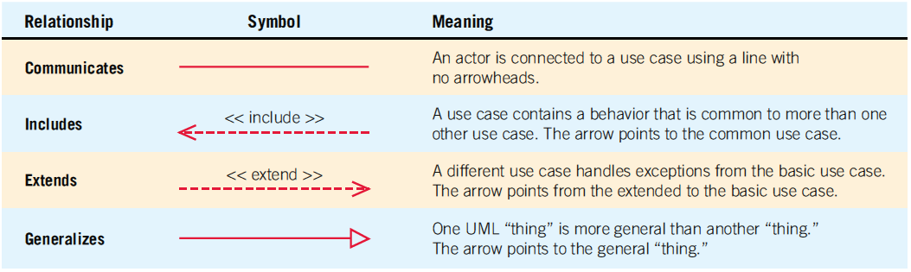
Four Types Of Behavioral Relationships And The Lines Used To Diagram Each
(Figure 2.13)
2-<number>

Slide 36
Some components of use case diagrams showing actors, use cases, and relationships for a student enrollment example (Figure 2.14)
2-<number>
Notes:
Communicates—used to connect an actor to a use case. The task of the use case is to give some sort of result that is beneficial to the actor in the system.
Includes—describes the situation in which a use case contains behavior that is common to more than one use case.
Extends—describes the situation in which one use case possesses the behavior that allows the new use case to handle a variation or exception from the basic use case.
Generalizes—implies that one thing is more typical than the other thing.

Slide 37
Scope
System scope defines its boundaries:
  What is in or outside the system
  Project has a budget that helps to define scope
  Project has a start and an end time
Actors are always outside of scope
Communication lines are the boundaries and define the scope
2-<number>

Slide 38
Developing Use Case Diagrams
Review the business specifications and identify the actors involved
May use agile stories
Identify the high-level events and develop the primary use cases that describe those events and how the actors initiate them
Review each primary use case to determine the possible variations of flow through the use case
The context-level data flow diagram could act as a starting point for creating a use case
2-<number>
Notes:
When diagramming a use case, start by asking the users to list everything the system should do for them.

Slide 39
A Use Case Diagram Representing a System Used to Plan a Conference (Figure 2.15 )
2-<number>
Notes:
Example of a use case diagram representing a system used to plan a conference.

Slide 40
Developing the Use Case Scenarios
The description of the use case
Three main areas:
  Use case identifiers and initiators
  Steps performed
  Conditions, assumptions, and questions
2-<number>
Notes:
Each use case has a description referred to as the use case scenario.

Slide 41
A Use Case Scenario Is Divided into Three Sections (Figure 2.16)
Use case name: Register for Conference |  | UniqueID: Conf RG 003
Area: Conference Planning
Actor(s): Participant
Stakeholder Conference Sponsor, Conference Speakers
Level Blue
Description: Allow conference participant to register online for the conference using a secure Web site.
Triggering Event: Participant uses Conference Registration Web site, enters userID and password, and clicks the logon button.
Trigger type:  External  Temporal
Steps Performed (Main Path) | Information for Steps
1. Participant logs in using the secure Web server | userID, Password
More steps included here…
12. Successful Registration Confirmation Web page is sent to the participant | Registration Record Confirmation Number
Preconditions: Participant has already registered and has created a user account.
Postconditions: Participant has successfully registered for the conference.
Assumptions: Participant has a browser and a valid userID and password.
Success Guarantee: Participant has registered for the conference and is enrolled in all selected sessions.
Minimum Guarantee: Participant was able to logon.
Requirements Met: Allow conference participants to be able to register for the conference using a secure Web site.
Outstanding Issues: How should a rejected credit card be handled?
Priority: High
Risk: Medium
2-<number>
Notes:
(First area)
Use case identifiers and initiators—orients the reader and contains:
1. The use case name and a unique ID
2. The application area or system that this use case belongs to
3. The actors involved in the use case
4. A brief description of what the use case accomplishes
5. The triggering event
6. Type of trigger:
external or temporal
external—those started by an actor
temporal—triggered or started by time
7. May list stakeholders
(Second area)
Includes the steps performed, and the information required for each of the steps.
(Third area)
Preconditions
Post conditions
Assumptions
Outstanding issues
optional statement of priority
optional statement of risk

Slide 42
Key Ideas
Use cases are a text-based method of describing and documenting complex processes
Use cases add detail to the requirements outlined in the requirement definition
Systems analysts work with users to develop use cases
Systems analysts develop process and data models later based on the use cases

Slide 43
Roles of Use Cases
A use case is a set of activities that produce some output result
Describes how the system reacts to an event that triggers the system
Trigger -- event that causes the use case to be executed
Event-driven modeling – everything in the system is a response to some triggering event

Slide 44
Modeling Use Cases
Complete piece of functionality
  Main flow/Main success scenario
  Subflows
  Exensions/Alternate flows

Slide 45
Role of Use Cases
All possible responses to the event are documented
Use cases are helpful when the situation is complicated

Slide 46
Sample Format for a
Written Use Case
Title – descriptive name, matches name in use case diagram
Primary actor – usually a user role
Stakeholders – any group or individual with an interest in the function of the use case
Precondition – conditions that must be satisfied in order to execute the use case

Slide 47
Sample Format for a
Written Use Case - 2
Minimal guarantee/Postcondition – outputs that can be expected if the service attempt failed
Success guarantee/Postcondition – outputs that can be expected if the service succeeds
Trigger – an event or action that initiates the use case
Main success scenario – description of sequence of interactions between actor and use case during the use case execution
Extensions – detailed description of how errors are dealt with

Slide 48
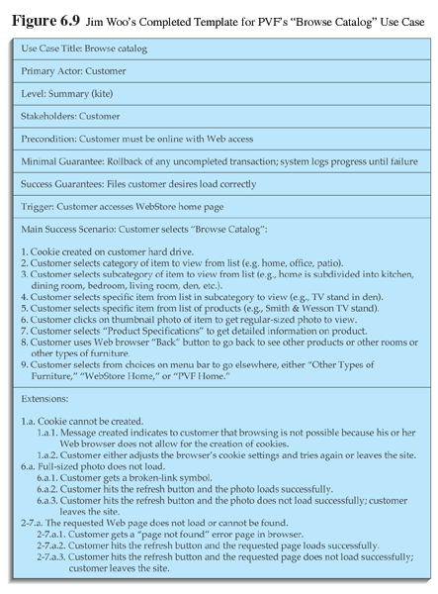
A sample written use case

Slide 49
Building Use Cases

Slide 50
Step 1:
Identify the major use cases
Activities | Typical Questions Asked
Start a use case form for each use case If more than nine, group into packages | Ask who, what, and where about the tasks and their inputs and outputs: What are the major tasks performed? What triggers this task? What tells you to perform this task? What information/forms/reports do you need to perform this task? Who gives you these information/forms/reports? What information/forms/reports does this produce and where do they go?

Slide 51
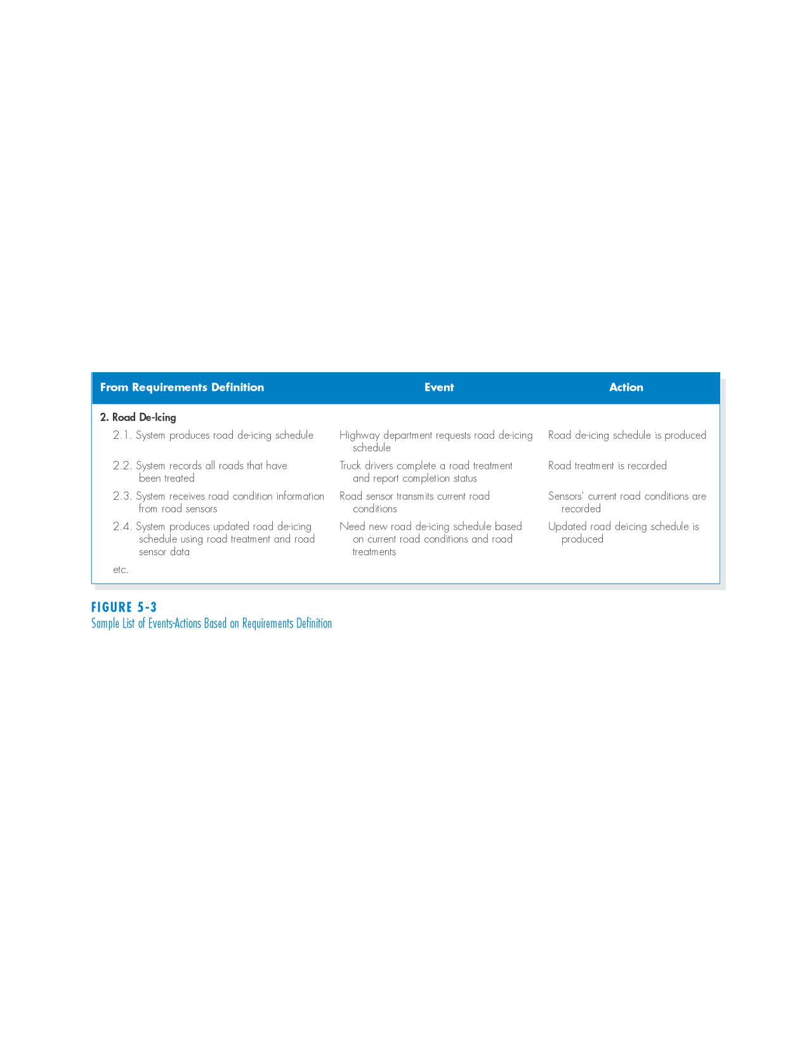
Sample List of Events-Actions Based on Requirements Definition

Slide 52
Step 2: Identify the major steps within each use case
Activities | Typical Questions Asked
For each use case, fill in the major steps needed to process the inputs and produce the outputs | Ask how about each use case: How do you produce this report? How do you change the information on the report? How do you process forms? What tools do you use to do this step (e.g., on paper, by email, by phone)?

Slide 53
Step 3:
Identify elements within steps
Activities | Typical Questions Asked
For each step, identify its triggers and its inputs and outputs | Ask how about each step How does the person know when to perform this step? What forms/reports/data does this step produce? What forms/reports/data does this step need? What happens when this form/report/data is not available?

Slide 54
Step 4:
Confirm the use case
Activities | Typical Questions Asked
For each use case, validate that it is correct and complete | Ask the user to execute the process using the written steps in the use case – that is, have the user role-play the use case

Slide 55
Interim Summary
Use cases contain all the information needed for process modeling, but are easier for users to comprehend
Use cases are created in an iterative cycle of steps until they are considered accurate and complete

Slide 56
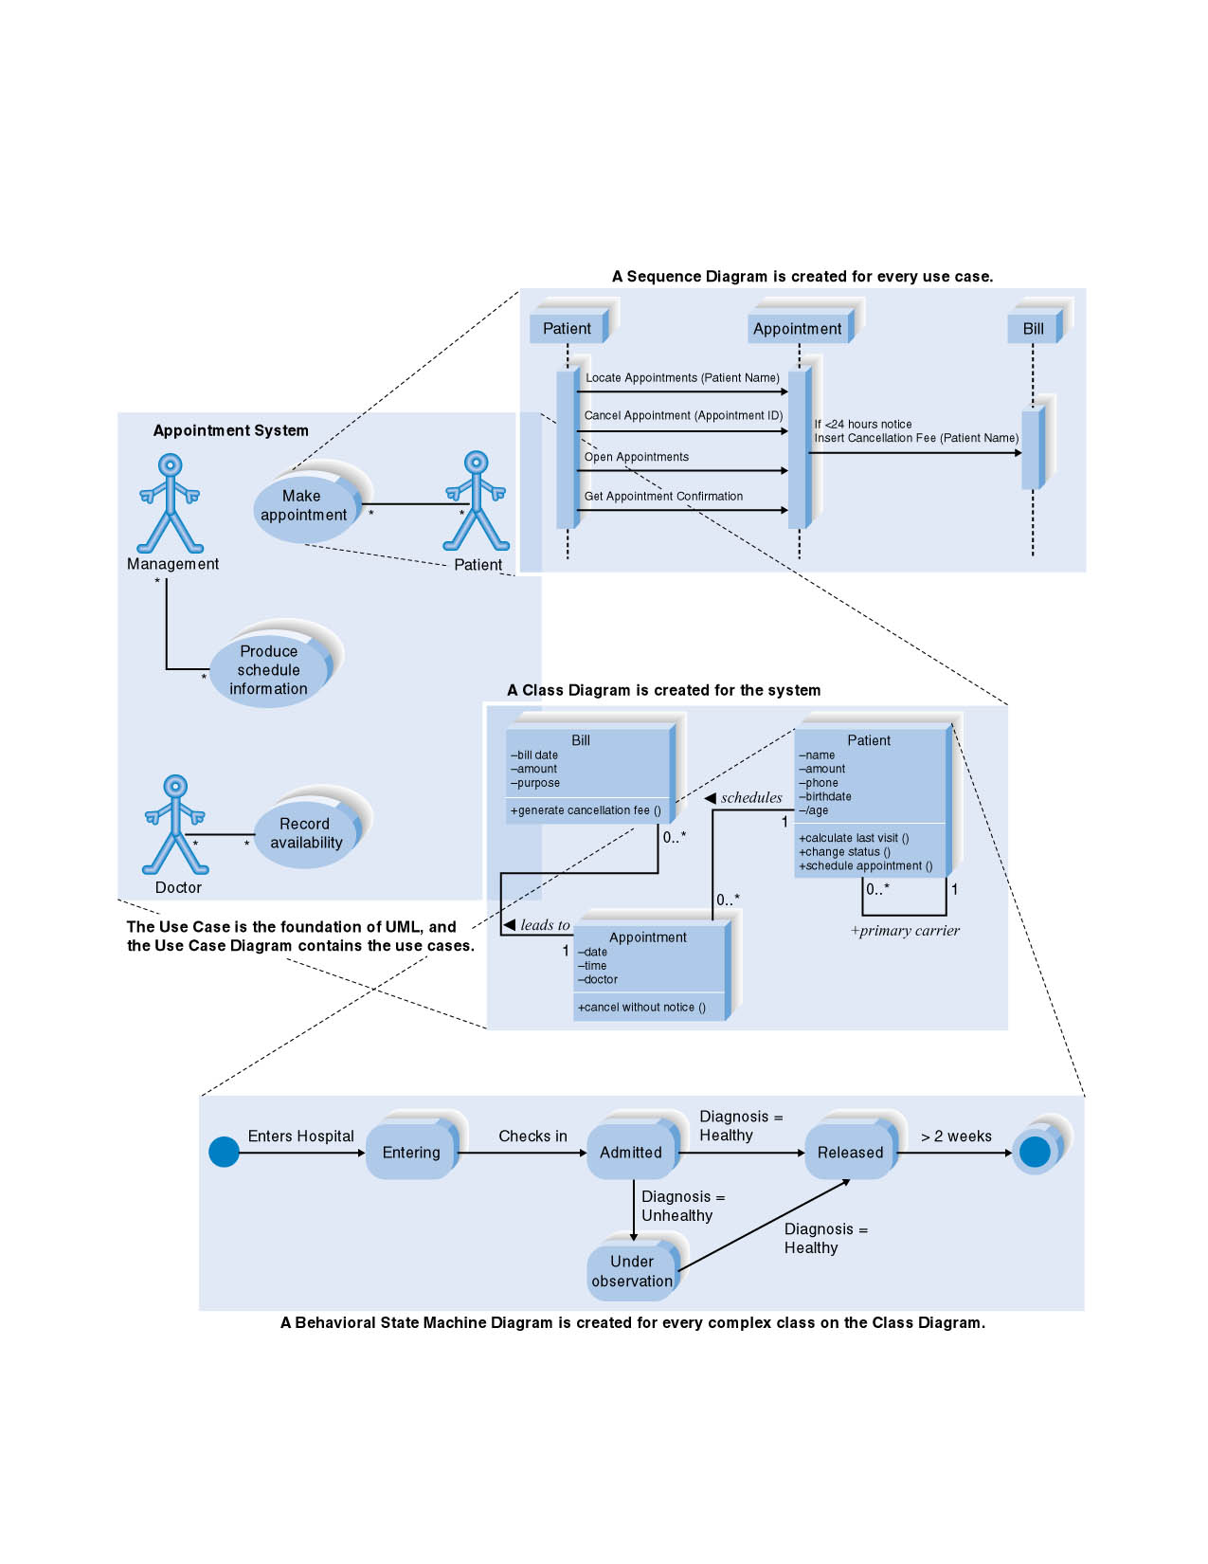
The Four Basic UML Diagrams

Slide 57
USE CASE DIAGRAM

Slide 58
Use Case Diagram Concepts
Summarizes all use cases (for the part of the system being modeled) together in one picture
Typically drawn early in the SDLC
Shows the associations between actors and use cases

Slide 59
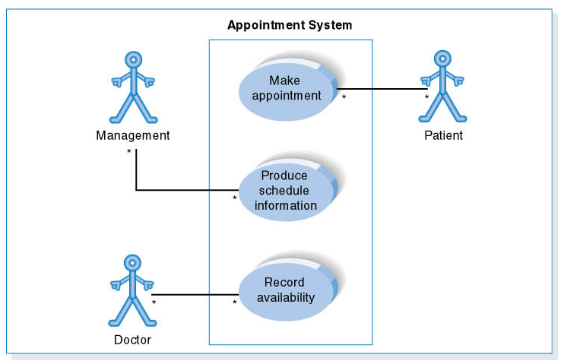
Use Case Diagram for Appointment System

Slide 60
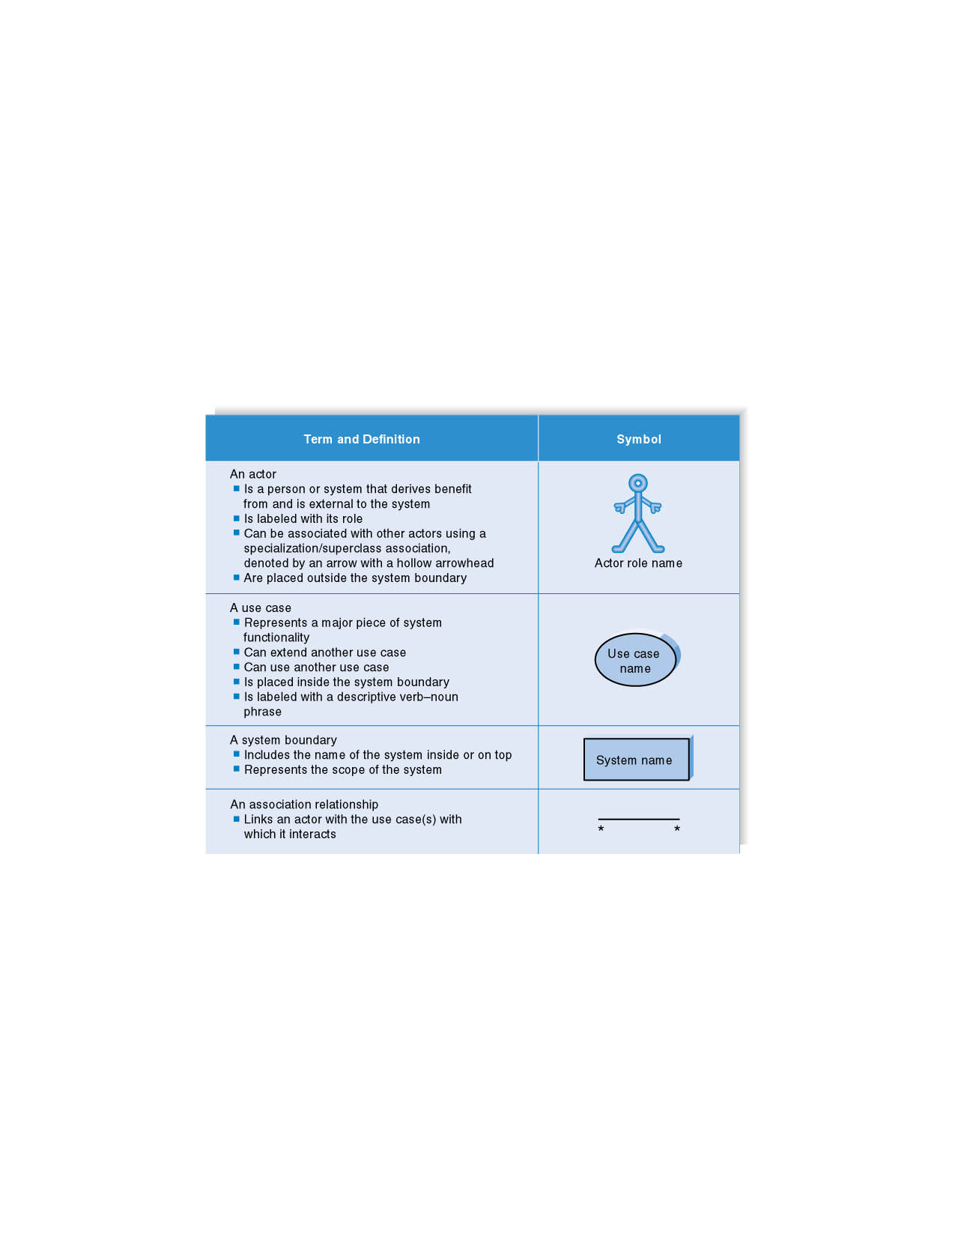
Syntax for Use Case Diagram

Slide 61
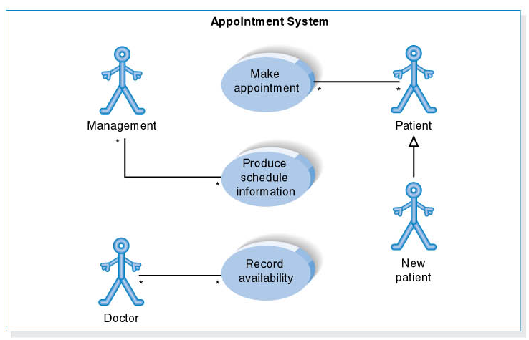
Use Case Diagram for Specialized Actor

Slide 62
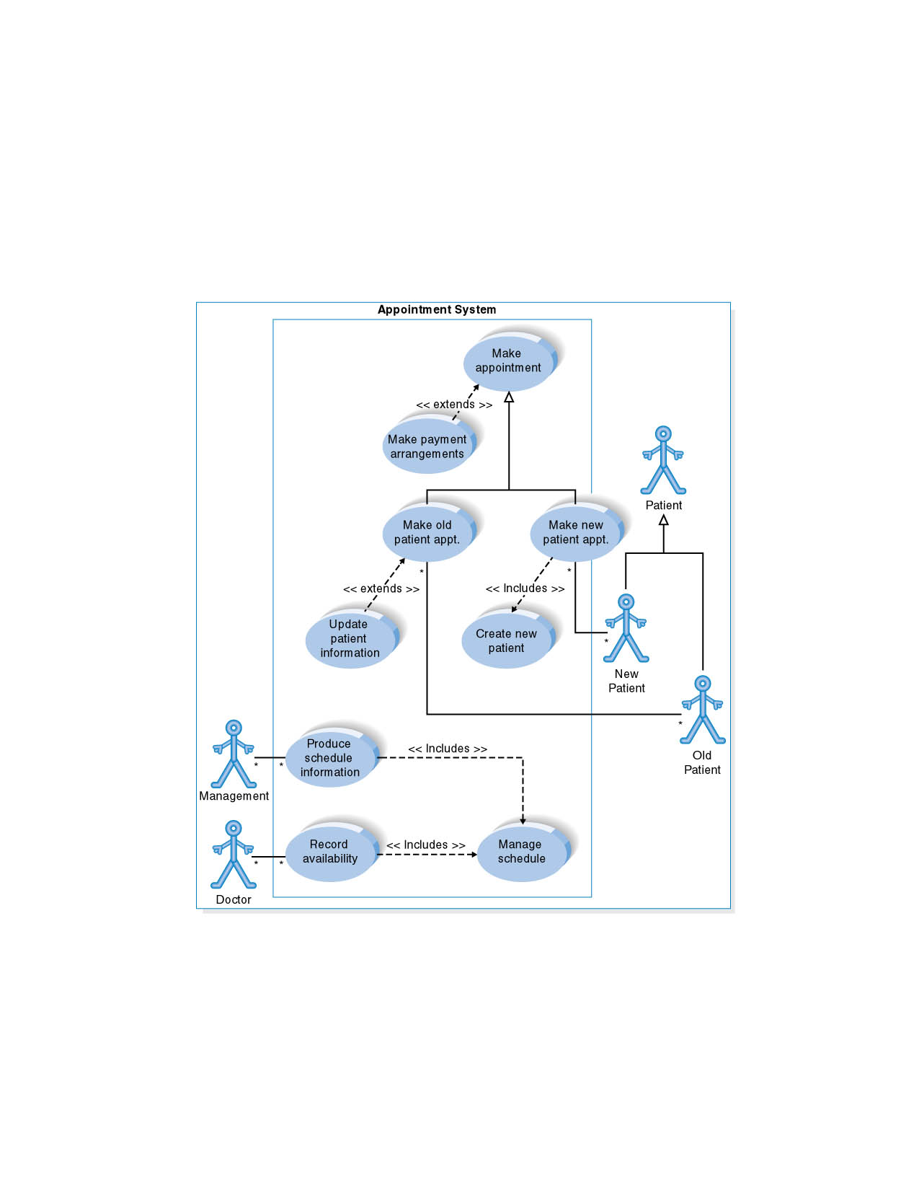
Extends and Includes Associations

Slide 63
Summary
Organizational fundamentals
  Organizations as systems
  Levels of management
  Organizational culture
Graphical representation of systems
  DFD
  ERD
  Use case diagrams and scenarios
2-<number>

Slide 64
Summary (continued)
Levels of managerial control
  Operational
  Middle management
  Strategic
Organizational culture
2-<number>

Slide 65

Copyright © 2014 Pearson Education, Inc.
Publishing as Prentice Hall
2-<number>

